Slide 1
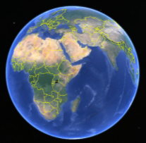
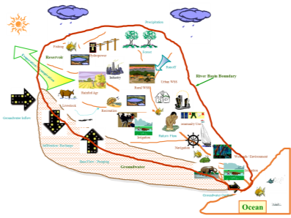

Global Water Needs
Nagaraja Rao Harshadeep (Harsh)
Global Lead (Watersheds)
The World Bank
International Seminar on National Hydrology Project
Towards reliable data acquisition system for IWRM
Pune, India
November 7, 2016

Slide 2






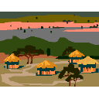

















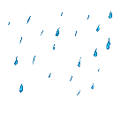
Multiple sectors, multiple institutions, linked by water and natural resources…
A Typical Watershed…
Agriculture Department
Precipitation
Livestock Department
Forest Department
Rural Water Supply Department
Fishing
Hydropower
Forest
Urban Water Supply Department
Reservoir
Irrigation Department
Evaporation / Transpiration
Runoff
River Basin Boundary
Power Department
Industry
Urban WSS
Industry Department
Rural WSS
Rainfed Agr
Fisheries Department
Livestock
Recreation
Groundwater Inflow
Environment Department
Community Use
Transport Department
Irrigation
Return Flow
Infiltration / Recharge
Tourism Department
Central & State Agencies
Surface & Groundwater Departments
Investment Institutions
Navigation
Wetlands / Environment
Base Flow / Pumping
Groundwater
Irrigation
Ocean Development/CZM Department
Basin Organizations; Other trans-boundary institutions
Farmers, Private Sector, Local Govt., NGOs, Academia, General Public …
…Need for Shared Vision supported by modern information, institutions, and investments…
Groundwater Outflow
Ocean

Slide 3
Scales
Micro-Watershed/Micro-Catchment
Sub-Watershed/Sub-Catchment
Watershed/Catchment
Sub-Basin
River Basin
Transboundary Water Contexts:
River Basins
Lake/Inland Sea Basins
Groundwater Aquifers
Marine Areas

Slide 4

What’s Broken?

Slide 5
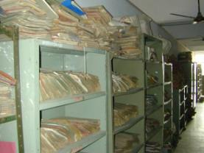
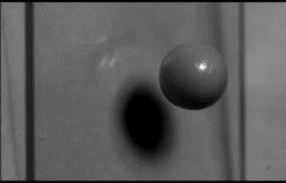
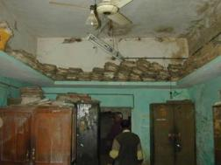
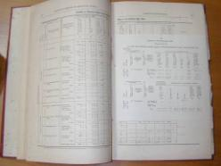
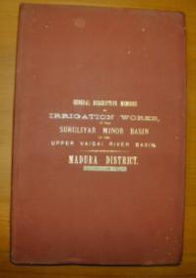
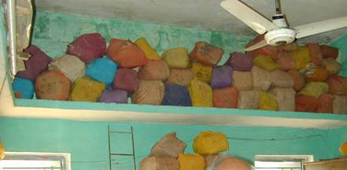
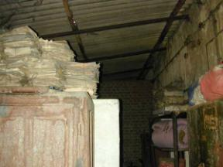
Challenges: Information
Data coverage and quality
Meaningful use of modern information and analytical tools
Public access to data, tools, and knowledge products

Slide 6


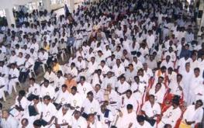
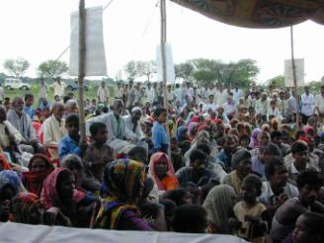
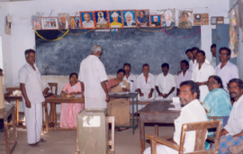
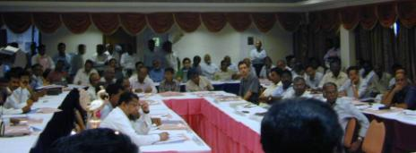
Challenges: Institutions
Vision of Hydromet and analytical Services needed (rather than just starting from equipment and models)
Limited technical and managerial capacity for modern water resources data and analytical knowledge tools (e.g. in Government, Academia, Private Sector, General Public; access to global expertise)
Institutional coordination and collaboration (across spatial and sectoral boundaries)
Meaningful stakeholder participation
Sustainability Focus
Effective leadership at all levels - sometimes a culture of “data-free analysis” and “analysis-free decision-making”

Slide 7
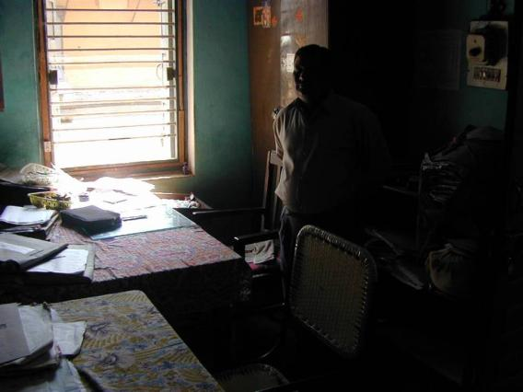
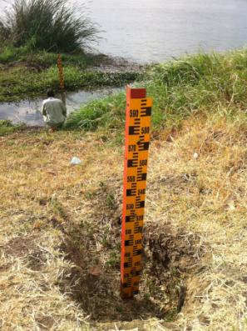
Challenges: Investments
Inadequate monitoring, forecasting, and analysis systems
Poor office infrastructure and equipment
Huge infrastructure deficit (power, transport, agriculture, sustainable land management…)
Investment planning & operational coordination

Slide 8
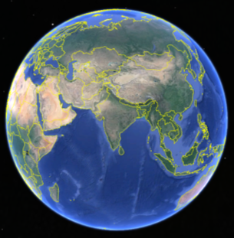
Modernizing Approaches to Address these Challenges…
The 3 Is…
Information & Analysis
Institutions & Policy
Investments & Operations

Slide 9
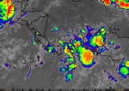
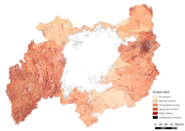
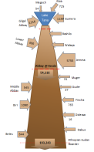
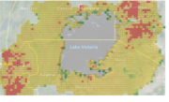
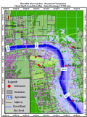
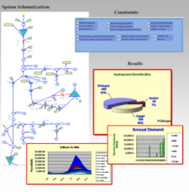
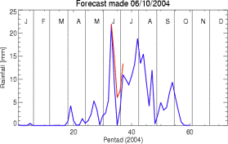
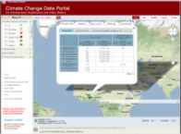
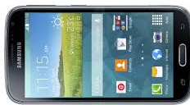
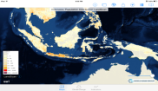
Information & Analysis
Resource Information Base (standards; harmonization; data rescue; monitoring; comprehensive spatial, temporal and other databases; improved use of satellite data; documents)
Knowledge Products/Special Studies (maps, Atlases, interactive toolkits, surveys)
Access and Outreach mechanisms (data services, publications, web portals, Apps with public access to open data services, technical/ success stories, multi-media documentation)
Analytical Tools (models/Decision Support Systems for planning/operations support in an integrated systems context)

Slide 10
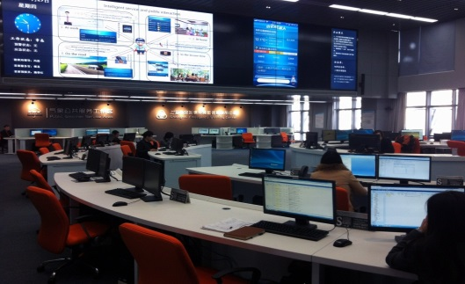
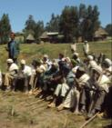
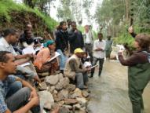
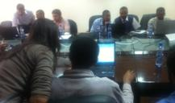

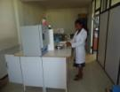
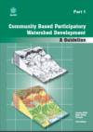
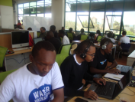

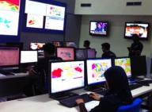


Institutions & Policy
Strengthening Institutions (office modernization, stakeholder participation, capacity development and training incl. distance learning, improved links with academia, internships, visiting experts, professional networks/ communities of practice; forums, competitions)
Strengthening Policies (streamlining institutional design/policy/mandates, improving synergy, economic instruments, decentralization)
Innovative Instruments (e.g. knowledge-driven facilitated diplomacy, policy instruments, incentive frameworks)

Slide 11
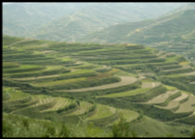
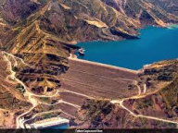

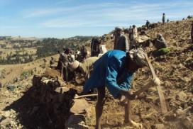
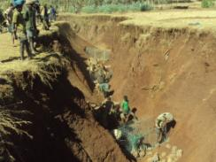
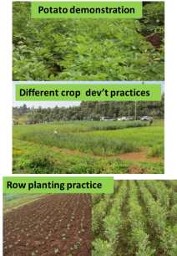
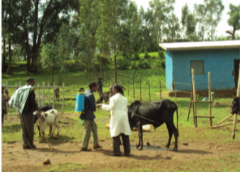
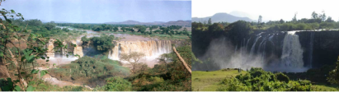
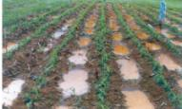
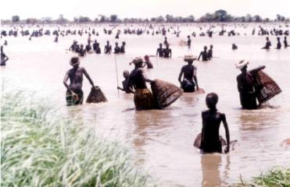
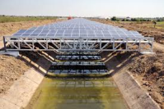
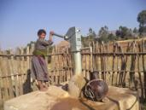
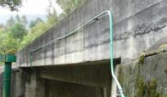
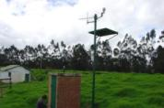
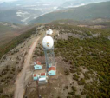
Investments & Operations
Preparation of robust climate-smart investments (with adequate attention to technical, environmental, social, economic, and institutional aspects) – upgrading existing infrastructure and building new infrastructure analyzed in a systems context
Implementation facilitation, monitoring, and lessons (adequate technical assistance, ownership, M&E)
Infrastructure planning and operational coordination in an IWRM context

Slide 12












Need to Focus on Decision Support Services to be Provided
Global Modeling Tools
Portals, Mobile Apps, Scenario Exploration Interfaces
Knowledge Base (real-time, archived)
Focus on Services to be Provided
Land use (e.g. Catchment Monitoring & Management, Landscape/ Watershed / Basin Planning, Zoning)
Control Rooms (e.g. for multi-sectoral decision support for strategy and operations)
Water Infrastructure Operations (e.g. barrages, dams, irrigation systems, hydropower, water supply)
Urban Climate Resilience (e.g. Stormwater management, Urban zoning)
Agricultural Information and Alerts (e.g. weather, pests, climate insurance)
Flood & Drought Early Warning & Response

Slide 13
Example #2: Deciding on Coping with Floods
Decision Support
Flood Coping Actions
(stakeholder actions to minimize loss of life / livelihood)
Dissemination
(Stakeholder Channels – DSS, Bulletins, SMS, Radio, TV, Social Media, Portals, Apps, Podcasts, phone, emails, …)
Knowledge
Flood Early Warning & Recommendations
Products & Services
(Formats, Frequency, Messaging, Customization, Media)
Weather Forecasts
Hydrologic Forecasts
Flood Inundation Forecasts
Information
Models
(Seasonal to nowcasting; statistical/ hydrologic systems/ hydrodynamic, …)
Data
Historical Climate, Flow, and Flooded area Data
Surveys
(detailed Digital Elevation Model, Soils, Water Infrastructure Status)
“Top-Down” Data
(from remote sensing/ earth observation products)
“Bottom-up” Data (from field gauges, manual reporting, crowdsourcing)

Slide 14
Integrated Water Resources Planning
Envisioning the Future
Point A:
Current Situation
Point B:
Future Vision
Strategy
The status of water management organizations today with respect to their capacity and capability to fulfill their mandate and carry out their functions
Where would each organization like to be 10-15 years into the future in terms of the services they would like to offer.
Institutions
Information
Investments
Support Program

Slide 15






Analytical & Stakeholder Tracks to Basin Planning…
Understanding Basin Issues/Problems (Pt. A – where now?)
Investment Facilitation/Implementation/Supervision
Shared vision for future potential
(Pt. Bs – where could the Basin be?)
Agreement on Basin Development Plan
Selection of development options
(getting from A to B)
Consensus on Additional Needs
Decisions→
Stakeholder Identification
Stakeholder
Involvement →
Analytical →

Slide 16














Information: Many new Innovations
GIS/Google Earth/Similar Products
Interactive Documents
New Learning Tools
Innovative Hardware
(e.g. Tablets)
Open Data Online Portals & Apps
Cloud storage/analytics/services

Slide 17




Data Rescue
Digitizer
Scanner

Slide 18















Building on curated public-domain datasets…
Climate Change (IPCC, TNC/WB)
Irrigated, Rainfed Areas (IWMI, FAO)
Historical Climate (CRU/UEA)
…
Climate/Flow data (KNMI, GRDC, …)
Gridded GDP (Yale, NOAA)
DEM (SRTM, ASTER)
CO2 emissions (EDGAR-JRC-PBL, …)
C Biomass (Winrock)
Flood/Drought (DFO, GDACS, UNEP…)
Biodiversity (CI, WWF, IUCN…)
Landcover (ESA, USGS, …)
Population (CIESIN, Landscan, …)
Soils (UNESCO, FAO, …)

Slide 19



















Modern “Bottom-up” Monitoring tools
Stilling Well/
Shaft Encoder
Bubbler
Non- Submersible Pressure Transducer
Float
Water Inlet
Automatic Rain Gauges
Doppler Radar
Snow Pack
ADCP
Shore-mounted Radar
Bridge-mounted Radar
Non-Contact Measurement of Stage & Discharge
Automatic Cableway System
Laboratories
Groundwater Monitoring
Water Quality Monitoring
Field Kits
Source of most graphics: Innovative Hydrology

Slide 20








Illustrative Options for Real-time Telemetry
Satellite
Terrestrial Radio
Mobile Network
Internet
Forecast/ Dissemination/ Decision Support Center/ Operational Control Room/ Water Center
Automatic Collection & Real-time Transmission
(e.g. GSM/GPRS, Terrestrial Radio, Satellite Radio, Meteorburst, broadband, etc. or combination possibly with local data logger storage backup)
Source: Innovative Hydrology

Slide 21





Many Eyes in the Sky…
Commercial
Disaster Monitoring Constellation
Pléiades
EROS A & B
FORMOSAT-2
IKONOS
QuickBird
RapidEye
SPOT
TerraSAR-X & TanDEM-X
COSMO-SkyMed
WorldView-1
WorldView-2
GeoEye-1
Planet Labs
Earth Observing System
Aqua&Terra (MODIS)
Aura
GRACE
Jason 1
Ocean Surface Topography Mission
Orbview-2
Orbiting Carbon Observatory 2
TRMM
GOES (Geostationary Operational Environmental Satellite)
GOES 13
GOES 14
GOES 15
Polar Operational Environmental Satellites
NOAA-15
NOAA-16
NOAA-18
NOAA-19
METOP-B
METOP-A
Joint Polar Satellite System
Suomi NPP
Japan Meteorological Agency
MTSAT-1R / Himawari-6[3]
MTSAT-2 / Himawari-7[3]
Landsat program
Landsat 7
Landsat 8
Brazilian Space Agency (AEB)
CBERS-1
CBERS-2
CBERS-2B
Argentina Space Agency (CONAE)
SAC-A
SAC-B
SAC-C
SAC-D
SAOCOM
Centre National d'Études Spatiales (CNES)
SPOT
Pléiades
TOPEX/Poseidon
European Space Agency (ESA)
Envisat
ERS (1 & 2)
CryoSat-2
Sentinel 1
Indian Space Research Organisation (ISRO)
Megha-Tropiques
Oceansat-2
IMS-1
Cartosat-2A
CARTOSAT-2
IRS P5 (CARTOSAT-1)
IRS P6 (Resourcesat 1)
JAXA
MOS-1 (Momo-1)
MOS-1b (Momo-1b)
JERS-1 (Fuyo-1)
ADEOS (Midori)
ADEOS II (Midori II)
GOSAT (Ibuki)
ALOS (Daichi) PALSAR, AVNIR-2 and PRISM
Lembaga Penerbangan dan Antariksa Nasional (LAPAN INDONESIA)
Lapan-TUBsat
NASA
TIMED (Thermosphere Ionosphere Mesosphere Energetics and Dynamics)
TOPEX/Poseidon
Upper Atmosphere Research Satellite
NOAA
NOAA-4
Project Vanguard
Vanguard 2
National Academy of Sciences of Republic of Belarus
BelKA
Pakistan's SUPARCO (Space and Upper Atmosphere Research Commission)
Badr-B - 2001.
Pakistan Remote Sensing Satellite - Scheduled 2014.
Russian Federal Space Agency (Roscosmos)
Elektro–L
Monitor-E
Resurs-DK1
Resurs-P No.1
Swedish National Space Board
Munin
Bolivarian Agency for Space Activities
VRSS-1
Meteosat
MetOp
Meteosat 5
Meteosat 6
Meteosat 7
Meteosat 8
Meteosat 9
RADARSAT series
RADARSAT-1
RADARSAT-2
South Korea
Arirang-1
Arirang-2
Arirang-3
Arirang-5
Chollian
THAILAND
Thaichote
Turkey
Göktürk-2 (2012) (IMINT),
RASAT (2011), Mapping
BILSAT-1 (2003-2006)
Göktürk-1 (2013) (IMINT),
Göktürk-3- (IMINT), High Resolution Synthetic aperture radar (SAR) Earth observation satellite
Weather
TIROS-1
TIROS-2
TIROS-3
TIROS-4
TIROS-5
TIROS-6
TIROS-7
TIROS-8
TIROS-9
TIROS-10
Meteor series
Meteor 1 series
Meteor 2 series
Meteor 3 series
FY (Feng Yun) series
FY-1 series
FY-2 series
FY-3A

Slide 22













“Top-down” Measurements from Space
“Space-based Rain Gauge” e.g. TRMM
Weather Products
“Space-based Stream Gauge” e.g. AMSR
“Space-based Reservoir Levels” e.g. TOPEX/JASON1&2/ENVISAT
“Space-based Groundwater monitoring” e.g. GRACE
+ Snowcover, Glaciers, Soil Moisture, Temperature, Evapo-transporation, Landcover, and much more…

Slide 23

















…that can be integrated into a modern Water Resources Information Services Platform (usable at regional, national, state, and local levels)
“Top-Down” Data Acquisition System
Web Portals/Apps
(e.g. integrated hydromet visualization platforms)
GIS and other datasets
Data Rescue
Satellite Earth Observation
Earth observation data access via suitable mechanisms (e.g. Internet, GeoNetCast)
Data Repositories
to store and serve
both raw feed and processed data
(on Cloud Platform)
Interaction with other Knowledge Base and Analytical Systems
Dissemination Platforms
Crowd-sourced / Community Surveillance Data
Stakeholder Alerts
Telemetry
(satellite, GSM, internet – incl. cellphone-based systems for manual monitoring)
Data Management & Modeling
(for weather, hydrological, inundation & other forecasts – short-term and seasonal; simulation, optimization, multi-criteria modeling)
Operational Control Rooms
Manual Monitoring
Automated Monitoring
Radars
“Bottom-up” Data Acquisition System

Slide 24







Planning
Modeling Tools
e.g. Eastern Nile Planning Model Project
Simulation
Optimization
Multi-Criteria Analysis

Slide 25





Flood Modeling
e.g. Demonstration of Value of Regional Cooperation for flood forecasting and warning improvement in Sudan, Ethiopia, and Egypt.

Slide 26



A new world for “last mile” connectivity
Multiple media
Internet
Cellphones
Flags
Preparedness plans
Flag hoisted at the community at Bhalkutia Mauza, Nagarpur Upazila showing rise in water level (blue flag) by 3 bighat
CEGIS Flood Info: Lautara 7-Sep-2007 14:21 ++ (Courtesy Banglalink)
Here,
A = Source of flood forecast message
B = Mauza name
C = Date
D = Time of sending message
E = Rise or fall of water level: One plus sign (+) means one bighat (22cm) rise of water level, one minus sign (-) means 1 bighat (22cm) fall of water level.
F=CourtesytoBanglalink
Source: http://pdf.usaid.gov/pdf_docs/PDACL719.pdf

Slide 27



Improving Seasonal Hydrologic Forecasts

Slide 28




Climate Change Data → Runoff → System Performance
TEMPERATURE
RUNOFF
PRECIPITATION
e.g. Hydropower Generation
Decision Support

Slide 29















Modernizing Water Centers (Regional, National…)
Collaborative Workspaces/Internships
Computer Training Room
Audio/Video-Conferencing/ Distance Learning/ Helpdesk
Document, Map & Digital Library
Innovation Marketplace
Situation/ Decision Rooms
Collation
Analysis
Use
Knowledge Repository
Monitoring Hub
Knowledge Tools/Products
Targeted Research
Outreach & Capacity-Building
Institutional Support

Slide 30
Evolving Modern Data & Tools
Innovations
Challenges
Data & Tools
  Remote Sensing (esp. Satellites)
  Modern Monitoring Systems
  Crowdsourcing/Crowdsensing
  Modern Data Services/APIs
  Big Data Analytics/Internet of Things
  Cloud Services (data and analysis)
  Free/Low-Cost Visualization & Analytical Tools
Institutional
  Public-domain Open data
  Modern, networked Water Centers
  Learning global good practice
  Integrating non-conventional stakeholders (Private Sector, Academia, CSOs, …)
  How to address evolving challenges?
  Adequate monitoring systems
  Awareness of modern data, tools, and techniques
  Knowledge of good practices
  Institutional Arrangements and Capacity
  Openness of data, models, products (e.g. in public-domain)
  Mindsets

Slide 31




Data Access and Visualization in the Public Domain
An Exciting New World Ahead!
Earth Observation Data
(e.g. mostly global data and knowledge products
on weather, land cover, floods, discharge,
groundwater, etc. from NASA, ESA, NOAA,
Regional and National Space Agencies, etc.)
Datasets from Regional and Local Institutions
(e.g. information on measured or computed detailed datasets on weather, flows, agriculture, generation, etc. from regional institutions, ministries, Universities, NGOs, private sector, etc.)
“Spatial Agent”
Other Datasets
(e.g. from publications, model outputs, data rescue of legacy paper data, crowd-sourcing, research, surveys, etc.)
Global Spatial Datasets
(e.g. topography, historical climate, hydrology, climate
change projections, land cover, snow, population,
administrative areas, gridded GDP, and a range of other
social, environmental, and economic indicators)

Slide 32



The Spatial Agent App: An Amazing World of Spatial Data at Your Fingertips!
Explore thousands of data layers from over 400 data services
Language facilitation in iOS (English, Spanish, French, Russian, Chinese, Arabic, Bahasa Indonesia)
Regular updates with exciting new features! Web versions coming soon!
Download free from: http://apps.worldbank.org
iOS (iPad and iPhone): search “Spatial Agent” on Appstore or from http://apple.co/2eVu5xJ
Android (older version on Google Playstore) new beta version at: http://bit.ly/2e24N2d
Do try out the App and send us your suggestions for improvement (e.g. more data services or functionality) at:
spatialagent@worldbank.org or harsh@worldbank.org

Slide 33

Spatial Agent App Interaction At-a-Glance
Time Series
Time Reference of time-series spatial data (e.g. dates, years)
Sub-Layers
Sub-categorization of data layers where available
Title
Title of selected data service
About
About Spatial Agent
Multi-media Tutorial (coming soon)
Send To
Send to Mail or Social Media
Feedback
Bookmark
Add (or manage) bookmarks for selected data service
Transparency
Select level of transparency of data atop base layer
“i” Information
Basic Metadata about selected data service (usually includes data service location and links to additional metadata)
Data Layers:
Country (national-level global data)
Sub-National (finer-resolution global data)
Trade (country-level global trade data)
  “Trade Data at a Glance” and select country for import/export treemaps)
  Commodity and country for timeseries graph
Showcase (non-global data for selected areas – e.g. region, country, basin, city)
Source
Source of Data Service
Visualization Categories
Maps (maps for most data)
Climate (comparison of climate change model projections)
Indicators (country-level data graphs)
Projects (world bank project mapping and project website links)
Also coming soon: GEF Projects, Google Earth Engine & other analyses
Zoom out
Zooms out to full global extent
Base Layers
A number of base layers on which data is displayed (e.g. street map, world imagery – the types vary by projection of selected data)
Boundary Overlays
Countries
Basins
Regions (major basins by region)

Slide 34



Thanks!
Dr. Nagaraja Rao Harshadeep
Global Lead (Watersheds)
The World Bank
1818 H St NW
Washington DC 20433
harsh@worldbank.org
Download the Spatial Agent App (iOS and Android) at: http://apps.worldbank.org

